Slide 1



Friendly, accessible description of the L-test to measure disinformation from incomplete incident reporting
Dr Keith Reid

Slide 2
These slides support the single A4 poster: “The L-test: an information-theoretical quantitative test for disinformation in safety reports” Associate Medical Director and Consultant Psychiatrist CNTW, Visiting Fellow & Doctoral Student, Northumbria University UK Faculty of Clinical Informatics Conference, June 2022 Keith.Reid@cntw.nhs.uk

Slide 4
Background
All hospitals report metrics, and absolute counts are largely infuenced by size
Sometimes they (we) drop the ball and give a false null report; some providers always seem to
False null reports distort the overall picture
I don’t mention any trusts (or private providers) here

Slide 5
Background
L-test is “about” measuring the false “information” added to a graph by a given false null report
The overall pattern matters because nulls
- demotivate true reporters
- distract regulators
- probably aren’t as good at governance (by definition)
- sometimes it’s illegal

Slide 6
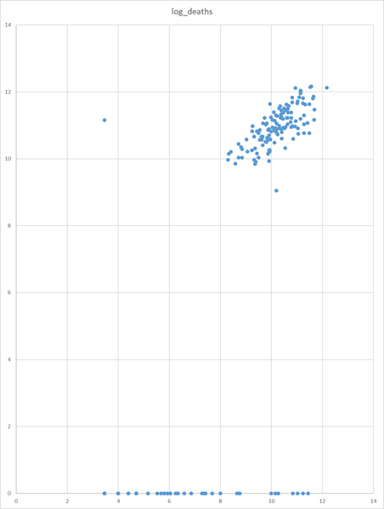
Real data is messy and incomplete
Log-Log scale of reasonably similar hospitals in one year about five years ago
An outlier
A group of places with deaths and
Claiming no sepsis at all
Log Sepsis cases reported
Log Deaths (adjusted SMR)

Slide 7
L
Real data is messy and incomplete
Log-Log scale of reasonably similar hospitals in one year about five years ago
An outlier
A group of places with deaths and
claiming no sepsis at all
Log-Log graphs give L-shape where there is a trend and claims of a null metric
Log Sepsis cases reported
Log Deaths (adjusted SMR)

Slide 8
L
Complete reports form the upright
The meaning of L
- coined by me as shape of
log log graph of paired metrics
- stands for Lewis by kind
permission of Seni’s family
- please frequently refute that
L stands for lie
Log Sepsis cases reported
Nulls form the base
Log Deaths (adjusted SMR)

Slide 9
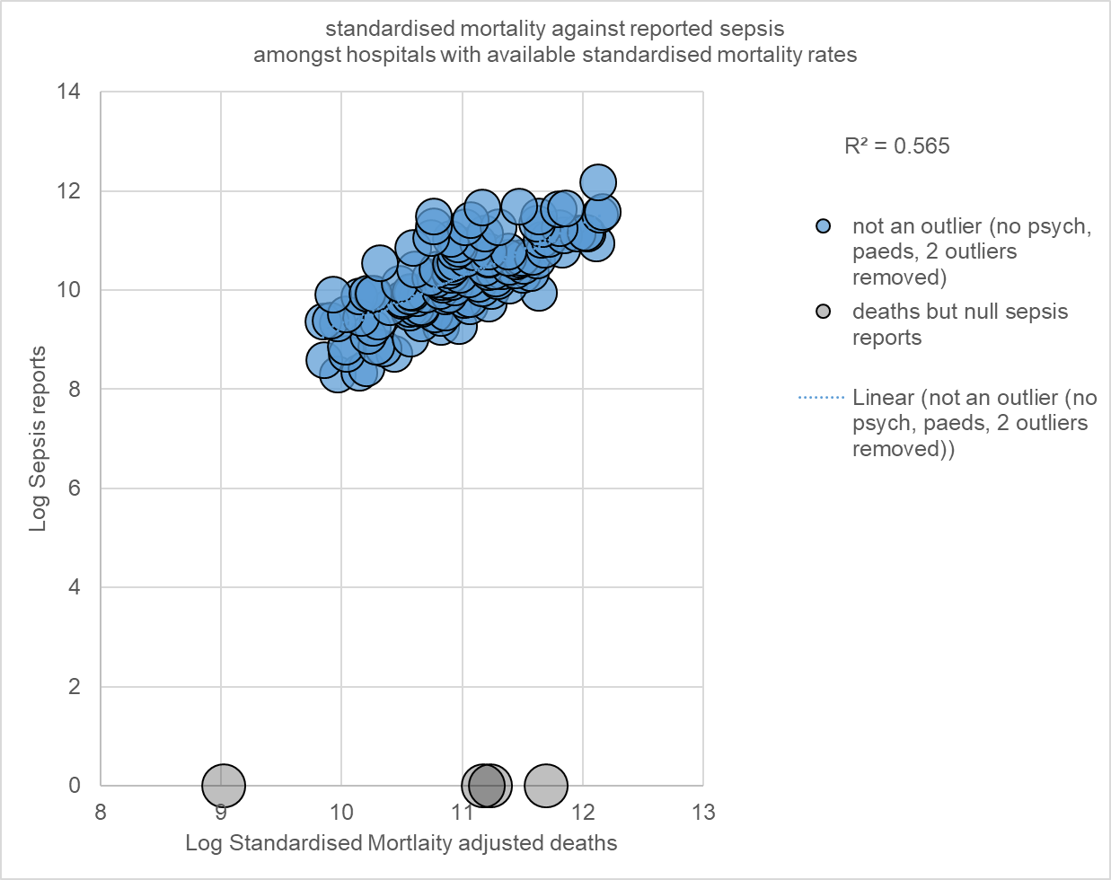
Abstracted graph and formal statement
Each hospital’s overall report of {a, b, ... m, n}, implicitly reports {(log a/log b) … (log c/log k)…(log m/ log n)}. Aggregated across providers they estimate a correlated typical relationship between, e.g. sepsis and death, or beds and restrained persons.
Null reports then seem by visual inspection to represent omissions.
The main cluster are similar, with little “information” between them. An alternately selected sample of the main cluster can be spoiled by having nulls added to it, so that spoiled cluster has a ratio of added “disinformation”. This can be compared to reference disinformative stories for illustrative purposes, and the most important nulls targeted for investigation.

Slide 10
Maybe this is the truth
In a submitted paper we* predicted two trusts’ restraint based on their size and their reports agreed when they began reporting.
*Reid K, Price O

Slide 11
Two maths ideas for the test
- Mann Whitney U is compares orders of two sets
- Shannon Information is information as in bits
Two maths ideas for comparators
- coin tosses
- prime counting

Slide 12
What is the Mann Whitney U test?
- tells you how likely it is that the relative order of two samples are
- under the assumption that both samples are taken from the from the same population
– relies on a rank score, and it uses the known distribution of that to give a probability.
Typical text book examples talk of whether fish from one lake or the other are larger, or the positions of school group sprints.
Here, most As beat most Bs though there appear to be some draws.
A A A A A A A
B B B B B B B B B

Slide 13
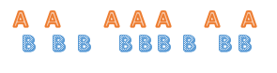
What is Shannon information?
For a given event, the amount of information is imparts is like how surprising it is. If p is low, information is high. In Mann Whitney U terms, if you expect an even mix, then...
This order of A vs B is more informative and less likely, and in the same way takes more bits to describe and these are the same thing
… than this order

Slide 14

Intuitively, this expectation means that
If we see this (yawn) it has high p and low information-surprise
But this is quite surprising
and informative
It also literally takes up
more bits* of information
as more complex pictures tend to
* bits as in binary digits

Slide 15
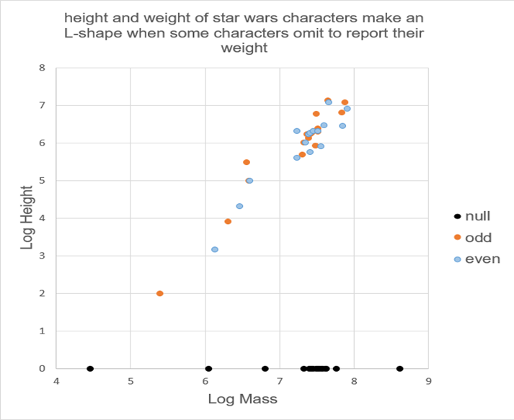
Science Fiction character height and mass
See the L-shaped scatter graph of science fiction character height and mass. Though the investigator knows the masses of the black dots, they have been spoiled, i.e. made null, for mass, to emulate omissions of safety incidents. Laplace correction gives null mass a notional value of 1kg, i.e. a log 0. Note height clusters around 150-200cm ~ human actor size. This is seen in nulls too.
Laplace correction is adding 1 to everything, to avoid
divide by zero errors and similar things.

Slide 16
Note that blue and orange dots are more like each other than the nulls.

Slide 17
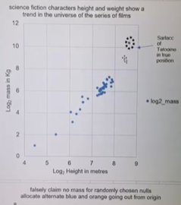
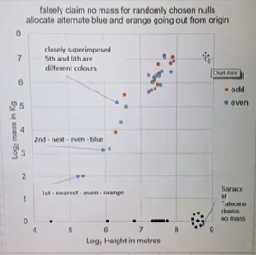
Sci fi data being run on an NHS computer using Excel

Slide 18
Methods
1. Split complete log-log report estimates from open source data e.g. restrained persons per month vs bed-days per month, into alternate halves E “even” and O “odd” going out from origin. This “toy” diagram uses science fiction character height vs mass.

Slide 19
Without nulls blues are quite like oranges and have little extra information
Intuitively, the story or overall impression of orange does not add much to the story or overall impression of blue
The additional orange information is probable in terms of blue and carries little extra information, it could be summarised/compressed briefly in few bits
~
orange v blue
p
H

Slide 20
Methods
1. Split complete log-log report estimates from open source data e.g. restrained persons per month vs bed-days per month, into alternate halves E “even” and O “odd” going out from origin. This “toy” diagram uses science fiction character height vs mass.
2. Count probability p(E~O) that E and O are similar using Mann-Whitney U test; p(E~O) tends to 1.0 for similar E and O.
3. Calculate h(E~O) information as –log(p(E~O)), tending to 0.0 for large similar E and O being “unsurprisingly” similar.
information h is -log(p) of an event… it’s just how many twos need to be multiplied under the 1 to get that p
… if there is a certainty that an event will happen it carries 0 bits of information because there are no 2s yet
… if there is 50% chance that an event will happen, p=0.5 it carries 1 bit of information, because 2 is 1*2
... if there is a 1/8 probability of an event, it carries 3 bits of information
… if there is a 1/16 probability of an event it carries 4 bits of information

Slide 21
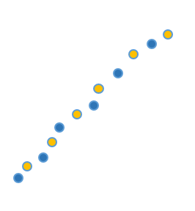

Without nulls blues are quite like oranges and have little extra information
With nulls blues are no longer like oranges and now have disinformative surprise – the nulls make the good guys look bad
p
H
~
orange v blue
p
H
orange v blueck

Slide 22
Sci fi data being run on an NHS computer using Excel

Slide 23
Methods
1. Split complete log-log report estimates from open source data e.g. restrained persons per month vs bed-days per month, into alternate halves E “even” and O “odd” going out from origin. This “toy” diagram uses science fiction character height vs mass.
2. Count probability p(E~O) that E and O are similar using Mann-Whitney U test; p(E~O) tends to 1.0 for similar E and O.
3. Calculate h(E~O) information as –log(p(E~O)), tending to 0.0 for large similar E and O being “unsurprisingly” similar.
4. Construct a noisy odd group “NO” made of O mixed with estimates from incomplete reporters, e.g. The largest character,
from a desert planet, reports mass of 1kg despite her height/depth of 2^8.6m, around 430cm, counting tentacles.
5. Calculate h(E~NO) information, approaching high values as incomplete reporters make E seem falsely surprising.
6. L-test is the proportional increase in h(E~O) due to disinformative noise in h(E~NO) :
h(E~NO) - h(E~O)
L = ---------------------------------
h(E~O)

Slide 24
Methods
6. L-test is the proportional increase in h(E~O) due to disinformative noise in h(E~NO) :
h(E~NO) - h(E~O)
L = ---------------------------------
h(E~O)
… like, how much bigger is the additional information in the spoiled group relative to the original clean
comparison between even and odd?

Slide 25
Results and Conclusions
L has desirable features:
- can be applied to single nulls or sets of nulls;
- MWU doesn’t need normally distributed data;
- degree of mathematical rigour;
- would also work with “falsely low” data points giving a lesser suprise;
- not reliant on estimates of null reporters;
- zero when there are no omissions;
- omissions affect noisier correlations less than tight ones.

Slide 26
Reference L-stories
Two comparators for disinformation are shared
mathematically disinformative reference stories
to give the sense of the scale of any disinformation.
Use an exclamation, as in the mathematical negation symbol, spoken as the particle “not”.
A: the coin toss reference story, “I tossed x coins in a row y times all of which came up heads!” … pronounced “...came up heads, not.”
B: the prime counting function story: “there are x integers in a row after y {a, b, c, …} which each have only one prime lower than them!” pronounced “...lower than them, not.”
Which can be used to give scale to statements such as “this hospital has 1234 deaths but no sepsis!”*
* not

Slide 27
A: the coin toss reference story,
“I tossed x coins in a row y times all of which came up heads!” … pronounced “came up heads, not.”

Slide 28
B: the prime counting reference story,
“There are X many integers after Y which only have one prime less than them!”

Slide 29
Pseudo code
Take complete reports
Split them in half
See how much the nulls spoil the even half of the complete reports in MWU terms, say by 22.9%
Go to story A program, and add unlikely coin toss series until the coin story is disinformative enough
Go to story B program, and add false prime counts until the prime count story is disinformative enough
Draw graphs

Slide 30
A: the coin toss reference story,
“I tossed x coins in a row y times all of which came up heads!” … pronounced “came up heads, not.”

Slide 31
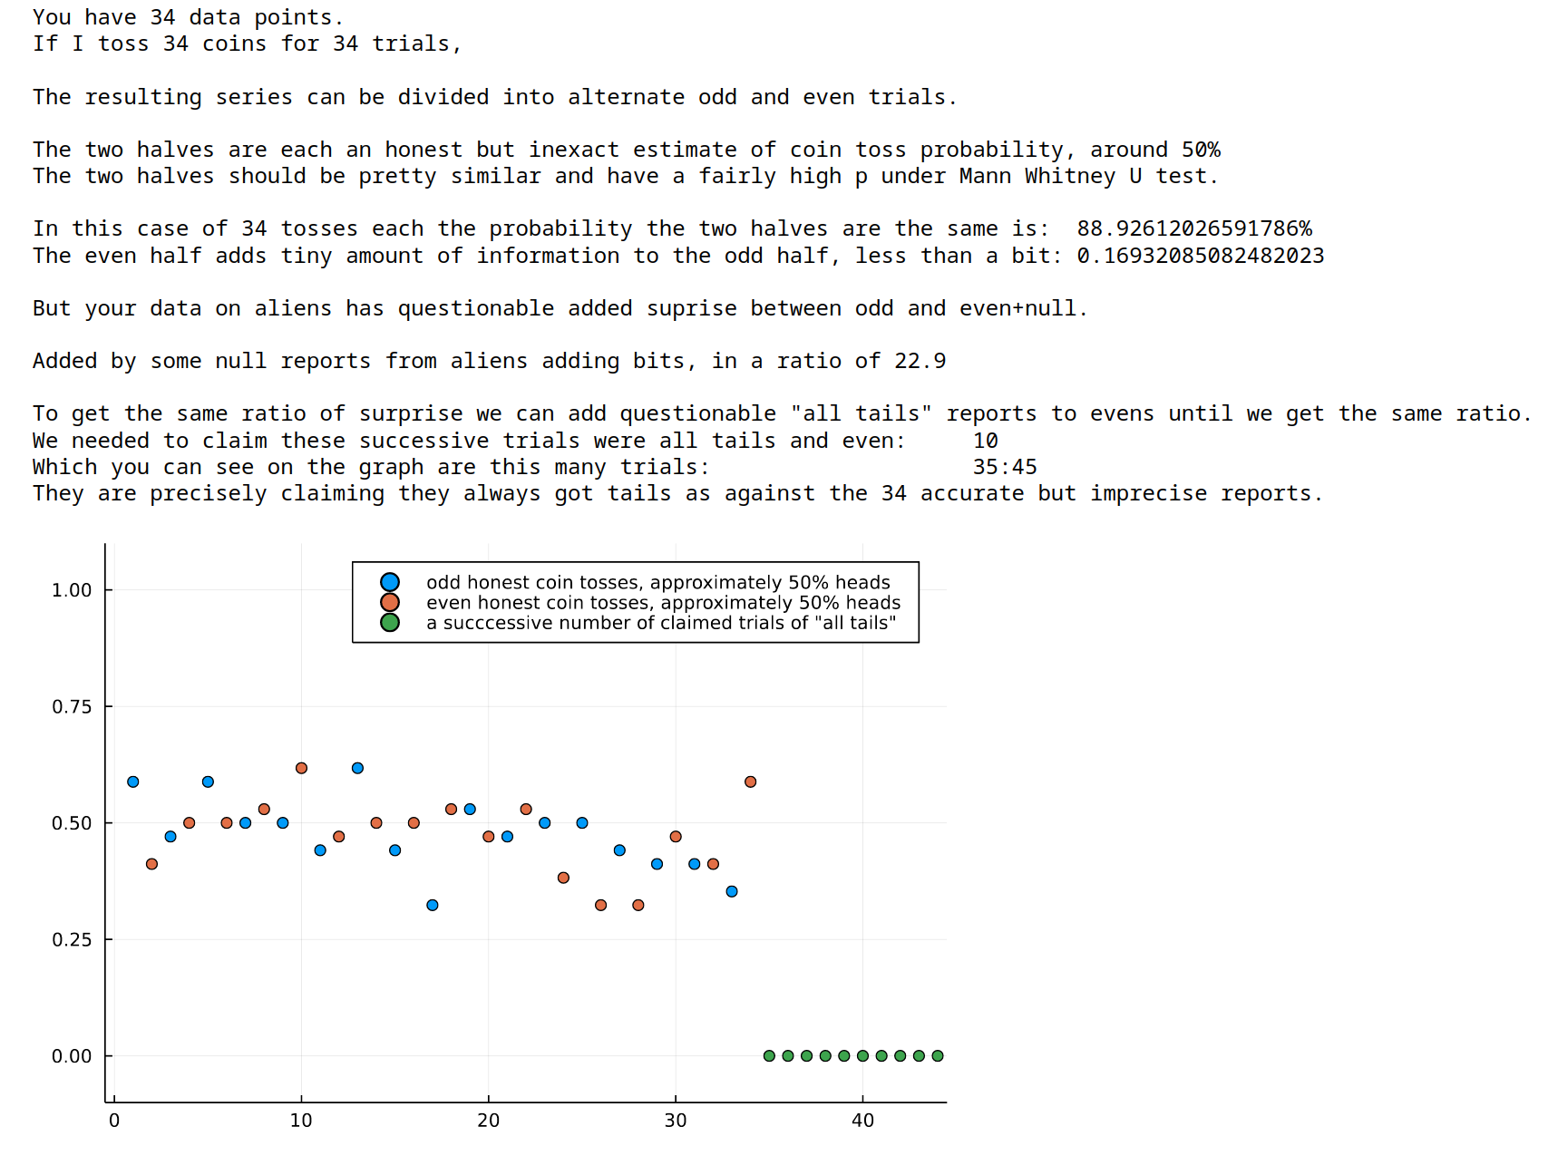
I tossed 34 coins ten times and they all came up the same!
*”not”

Slide 32
B: the prime counting reference story,
“There are X many integers after Y which only have one prime less than them!”

Slide 33
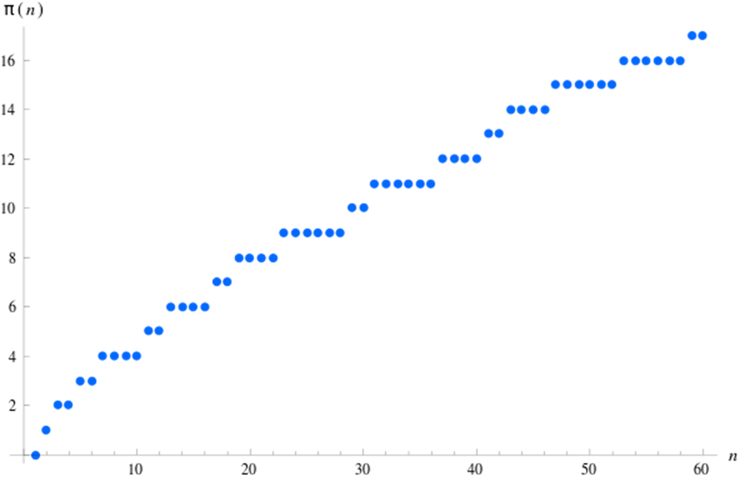
Here is the real prime counting function
Infinite, slightly unpredictable.
2 has 1 prime less than or equal to it, i.e. self {2} <1 is not prime>
10 has 4 which are { 2, 3, 5, 7 }
million bucks if you solve it
Wikipedia

Slide 34

B: the prime counting function reference story: “there are x integers in a row after y {a, b, c, …} which each have only one prime lower than them!” … pronounced “lower than them, not.”

Slide 35
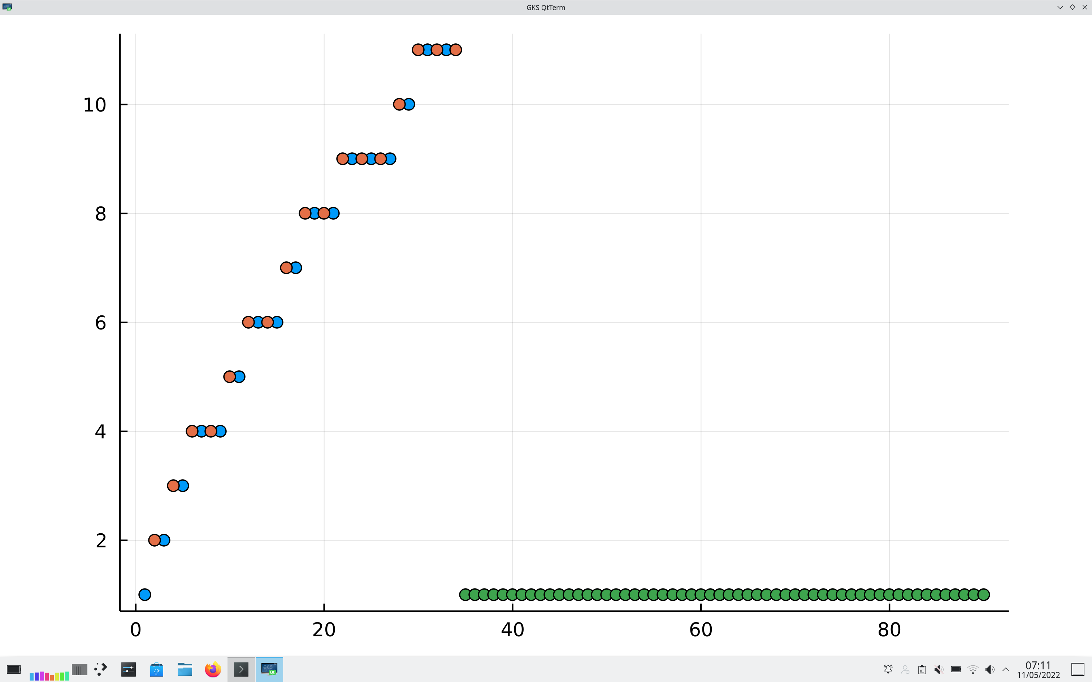
B: the prime counting function story: “there are x integers in a row after y {a, b, c, …} which each have only one prime lower than them!” … pronounced “lower than them, not.”
The green dots claim that although successive integers have a mildly unpredictable number of primes less than them, “there are 65 integers after 34 that each have only one prime less than them!*”
*not

Slide 36
Please note we call these stories reference stories, because L does not stand for lie!*
* warning: recursive joke

Slide 37
L-test, then, is increased if complete reports seem falsely surprising consequent to noise from incomplete reports.
It is named for Seni Lewis with kind permission of his family and with reference to the characteristic shape that omissions make on a log-log scatter graph. L-test can tell investigators which incomplete reports skew the overall picture most. In a context of restricted resource, regulatory efforts could concentrate on the omissions which have the most distorting effect - the biggest L-score. Those will be large omissions in otherwise well correlated fields. Incident registers and minimum data sets are ubiquitous and null reports do exist, so there are opportunities.
The L-test of scores of restraint data against size in England are in similar to the science fiction data L-tests.
My next project is trying to make MWU Exact, like Fishers is more exact than Chi Squared, broadly continuing the binary reasoning using Knuth’s relevant chapters.

Slide 38
Thanks to
Asahi Linux, CNTW R&D, Northumbria Uni Faculty of Life and Health Sciences, Northumbria Uni Faculty of Business and Law, Peter McMeekin, Mick Hill, Simon Douglas, Ron Weddle, Aji Lewis, CNTW coders club, CNTW stats questions group, CNTW Positive and Safe Team

Slide 39
Coded in Julia in Vim and Jupyter on an Apple M1 with Asahi Linux with Test Driven Development
Repo: keithreid-sfw
Citations:
- Mackay
- Shannon
- Mann Whitney U
- U-tests in general
- Knuth
- Wookiepedia, Kaggle, NHS MHMDS, sepsis data

